Slide 1
LE SWITCH
RENAULT Marion
FRANÇOIS-ROSE Kathleen

Slide 2
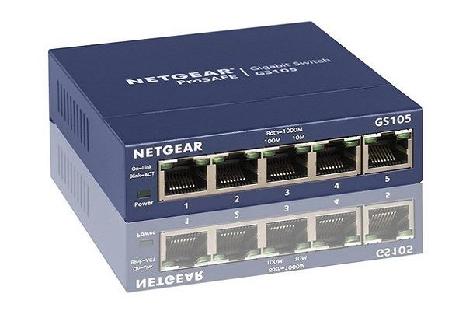
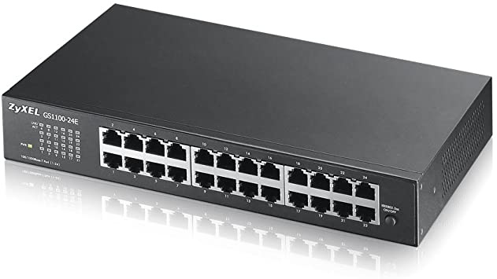
Qu’est-ce que c’est ?

Slide 3
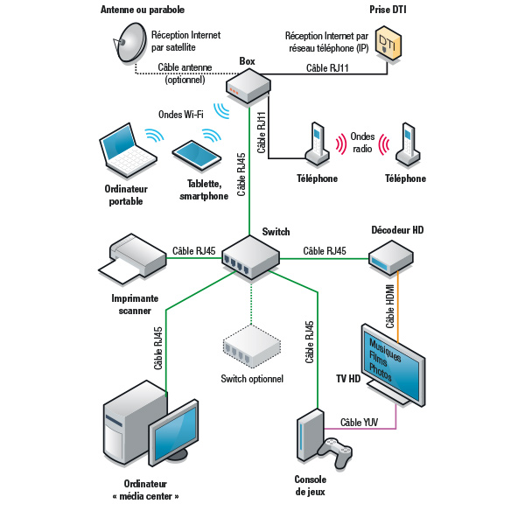
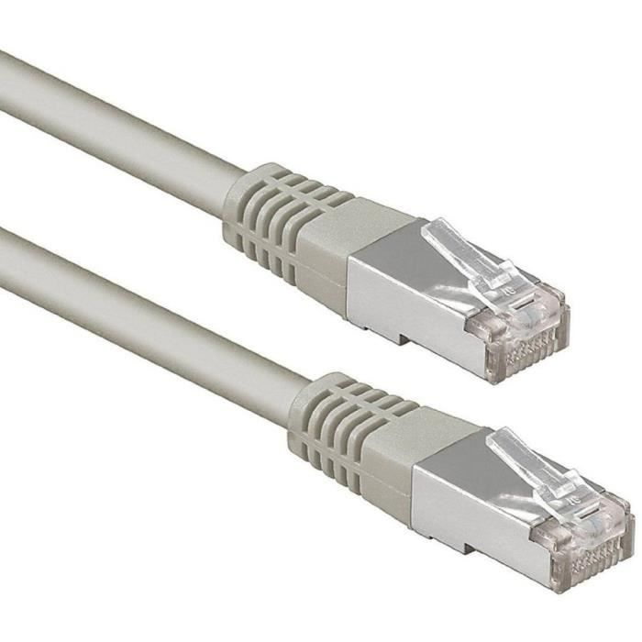
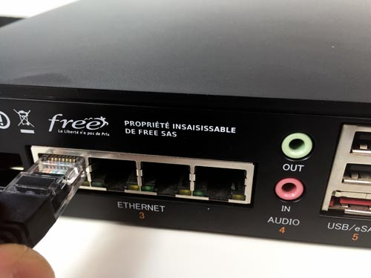
Branchement et réseau filaire du switch

Slide 4
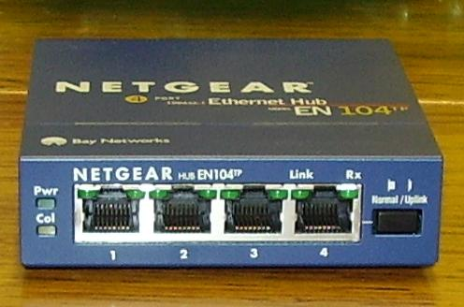
Hub (concentrateur réseau)

Slide 5
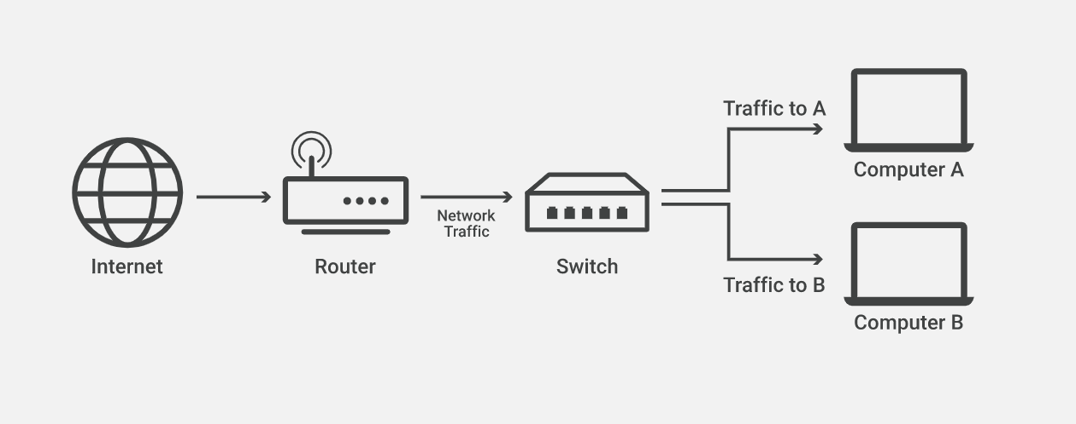

Slide 6
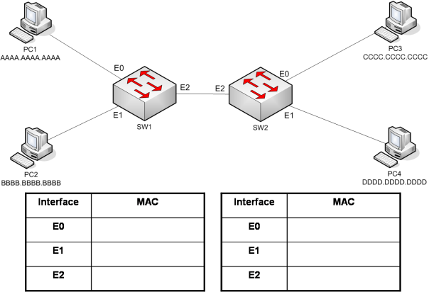
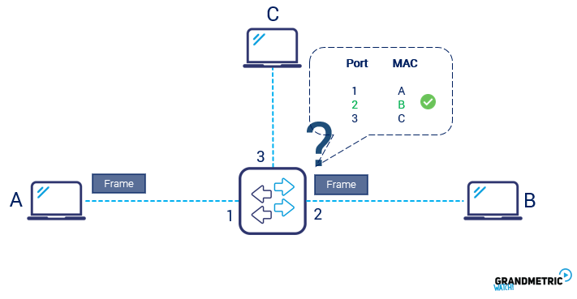
Exemple d’adresse MAC

Slide 7
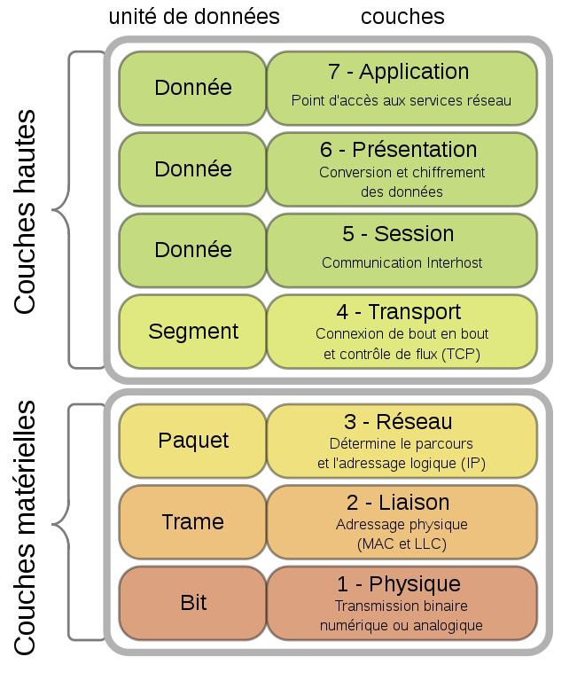
Couches OSI (Open Systems Interconnection)

Slide 8
GLOSSAIRE
Data : donnée
Ethernet port : port ethernet
Frame : trame
Hub : concentrateur réseau
Local area network (LAN) : réseau local (LAN)
MAC address (media access control address) : adresse MAC ou adresse physique
Network traffic : trafic réseau
Packet : paquet
Residential gateway : box internet
Router : routeur
Switch : commutateur réseau
Wide area network (WAN) : réseaux étendus (WAN)

Slide 9
SOURCES
http://www.technologyuk.net/computing/computer-networks/network-technologies/interconnection-devices.shtml
https://www.techno-science.net/definition/11362.html
https://www.cloudflare.com/fr-fr/learning/network-layer/what-is-a-network-switch/
https://le-routeur-wifi.com/switch-ethernet-commutateur/
https://www.systemed.fr/electricite/switch-pour-reseau-filaire-simple-et-centralise,4792.html
https://www.commentcamarche.net/faq/2238-reseaux-concentrateur-hub-commutateur-switch-et-routeur
https://fr.esdifferent.com/difference-between-switch-and-hub
https://reussirsonccna.fr/switch/
https://community.fs.com/fr/blog/layer-2-switch-vs-layer-3-switch-what-is-the-difference.html
https://www.tomshardware.fr/comprendre-le-switch-reseau-commutateur/

Slide 10
TRADUCTION :
The switch is a relatively new network device that has replaced both hubs and bridges in LANs. A switch uses an internal address table to route incoming data frames via the port associated with their destination MAC address. Switches can be used to connect together a number of end-user devices such as workstations, or to interconnect multiple network segments. A switch that interconnects end-user devices is often called a workgroup switch. Switches provide dedicated full-duplex links for every possible pairing of ports, effectively giving each attached device its own network segment This significantly reduces the number of intra-segment and inter-segment collisions.
A number of network segments on the same floor of a building (or on the same campus), each having thier own workgroup switch switch, may themselves be connected together by a higher level switch known as a floor switch. Much more powerful switches are often used to connect together a number of high-level network devices, such as floor switches, workgroup switches and routers. These devices are often called core switches, and they should have sufficient capacity to cope with the volume of traffic flowing around the network.
Switches are the heart of all computer networks and are responsible for connecting up to 1000's of computers together.
A network switch looks a lot like a network hub. Unlike hubs, however, network switches are capable of inspecting incoming messages as they are received and directing them to a specific port—this creates an arp table on the switch so it knows where each device is and where to send the traffic destined for that device.
A switch determines the source and destination addresses of each packet and forwards data only to the specific devices, while hubs send the data to every port except the one that received the traffic.

