Slide 1
LE PROCESSEUR
Loys Gohier et Crosas Louisa

Slide 2
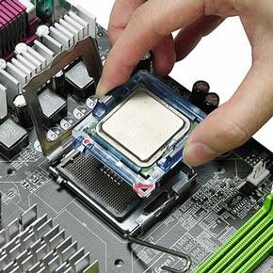
Qu’est-ce qu’un processeur ?

Slide 3
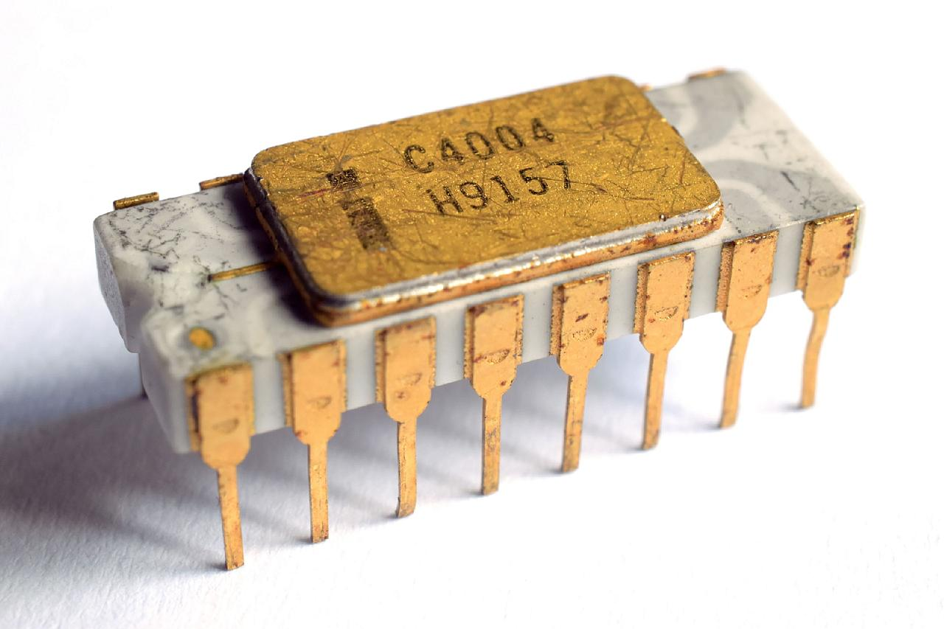
Histoire du processeur
Le premier processeur commercialisé (Intel 4004)
L’un des premiers ordinateurs à programme enregistré

Slide 4
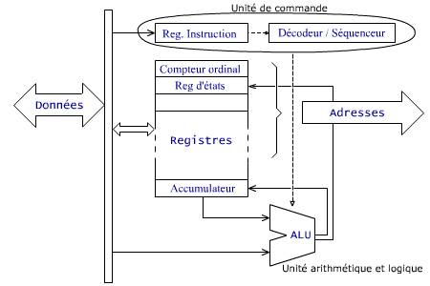
Fonctionnement
Les différentes parties du processeur :
Unité de commande
ALU
Registres
Horloge
Bus
→
→
→
→

Slide 5
Les transistors
Il ne mesurent que quelques nanomètres
Il y en a plus d’un milliard dans les processeurs les plus récents
Transistors → circuits logiques → processeur

Slide 6
TEXTE
Central Processing Unit (CPU)
A Central Processing Unit is also called a processor, central processor, or microprocessor. It carries out all the important functions of a computer. It receives instructions from both the hardware and active software and produces output accordingly. It stores all important programs like operating systems and application software. CPU also helps Input and output devices to communicate with each other. Owing to these features of CPU, it is often referred to as the brain of the computer.
CPU is installed or inserted into a CPU socket located on the motherboard. Furthermore, it is provided with a heat sink to absorb and dissipate heat to keep the CPU cool and functioning smoothly. Generally, a CPU has three components: ALU (Arithmetic Logic Unit) / Control Unit / Memory or Storage Unit.
Control Unit: It is the circuitry in the control unit, which makes use of electrical signals to instruct the computer system for executing already stored instructions. It takes instructions from memory and then decodes and executes these instructions. So, it controls and coordinates the functioning of all parts of the computer. The Control Unit's main task is to maintain and regulate the flow of information across the processor. It does not take part in processing and storing data.
ALU: It is the arithmetic logic unit, which performs arithmetic and logical functions. Arithmetic functions include addition, subtraction, multiplication division, and comparisons. Logical functions mainly include selecting, comparing, and merging the data. A CPU may contain more than one ALU. Furthermore, ALUs can be used for maintaining timers that help run the computer.
Memory or Storage Unit/ Registers: It is called Random access memory (RAM). It temporarily stores data, programs, and intermediate and final results of processing. So, it acts as a temporary storage area that holds the data temporarily, which is used to run the computer.
What is CPU Clock Speed? The clock speed of a CPU or a processor refers to the number of instructions it can process in a second. It is measured in gigahertz. For example, a CPU with a clock speed of 4.0 GHz means it can process 4 billion instructions in a second.
https://www.javatpoint.com/central-processing-unit

Slide 7
Gossaire
CPU (Central Processing Unit) = UCT (Unité Centrale de Traitement)
Microprocessor = microprocesseur
Motherboard = carte mère
ALU (Arithmetic and Logical Unit) = UAL (Unité Arithmétique et Logique)
Control Unit = Unité de contrôle
RAM random access memory = mémoire vive
Core = coeur
Transistor = transistor
Integrated circuit = circuit intégré
Clock = horloge

Slide 8
Sources
https://fracademic.com/dic.nsf/frwiki/824709
https://cours-informatique-gratuit.fr/cours/processeur-et-carte-mere/
https://www.lemondeinformatique.fr/actualites/lire-intel-celebre-le-40e-anniversaire-de-sa-puce-4004-46701.html
https://www.youtube.com/watch?v=zjY17c7WNNw
https://www.monpcsurmesure.fr/guides/choisir-son-processeur.html
https://www.journaldunet.fr/web-tech/dictionnaire-du-webmastering/1445300-processeur-definition-fonctionnement-et-frequence/
http://www.courstechinfo.be/Techno/CPU.html
http://electroniqueamateur.blogspot.com/2016/01/

