Slide 1
Les serveurs
Marché de la science

Slide 2
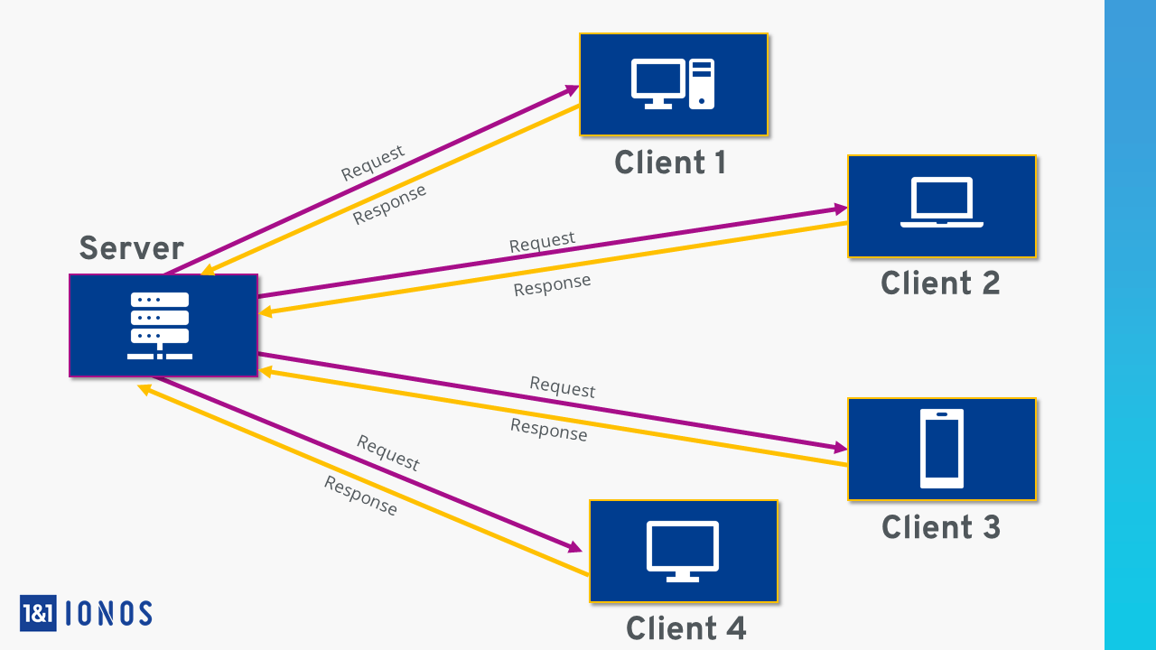
Qu’est ce qu’un serveur ?
Ordinateur
Réseau
Client
Routeur
Hardware
Software

Slide 3
Comment ça fonctionne ?
Modèle client/serveur
Requête
Données
Programmes clients
Ressources centralisées
Baies serveur

Slide 4
Hebergeur
Serveur matériel
Serveur dédié
Site web
Serveur mutualisé
VPS
Cloud
Parc de serveurs

Slide 5
Serveur logiciel
Logiciel de serveur web
Logiciel de serveur d’application
Logiciel de serveur de gestion de base de données
Logiciel de serveur de fichiers
Logiciel de serveur de nuage informatique

Slide 6
Texte à traduire
There are both similarities and differences between desktop computers and servers. Most servers are based on X86/X64 CPUs and can run the same code as an X86/X64 desktop computer. Unlike most desktop computers, however, physical servers often include multiple CPU sockets and error correcting memory. Servers also generally support a far greater quantity of memory than most desktop computers.
Because server hardware typically runs mission-critical workloads, server hardware manufacturers design servers to support redundant components. A server might for instance be equipped with redundant power supplies and redundant network interfaces. These redundant components allow a server to continue to function even if a key component fails.
Server hardware also differs from desktop hardware in terms of its form factor. Modern desktop computers often exist as mini towers, designed to be placed under a desk. Although there are still some vendors that offer tower servers, most servers are designed to be rack mounted. […]
Another key difference between desktop computer and a server is the operation system. A desktop operating system might be able to perform some server-like functionality but isn’t designed or licensed to take the place of a server operating system. Windows 10, for example, is a desktop operating system. Some Windows 10 editions include Hyper-V, Microsoft’s virtual machine platform. Even though both Windows 10 and Windows Server can run Hyper-V, Windows 10’s hypervisor is intended to be primarily used for development purposes, whereas the version of Hyper-V included with Windows Server is designed for running production virtual servers.
Source : https://whatis.techtarget.com/definition/server

Slide 7
Glossaire
FRANÇAIS | ANGLAIS
Adresse IP Baie serveur Centre de donnée Hébergement dédié Hébergement mutualisé Hébergeur Logiciel Matériel Modèle client-serveur Parc de serveurs Port Réseau Requête Routeur Serveur Serveur virtuel privé | IP address Server cabinet Data center Dedicated hosting Shared hosting Host Software Hardware Client/Server model Server park Port Network Query Router Server Virtual private server (VPS)

Slide 8
Sources
https://www.ionos.fr/digitalguide/serveur/know-how/quest-ce-quun-serveur-une-notion-deux-definitions/
https://www.commentcamarche.net/contents/222-environnement-client-serveur
https://pixees.fr/informatiquelycee/n_site/nsi_prem_clsv.html
https://www.techno-science.net/definition/3743.html
https://hebergeurs.top/serveur-dedie-definition
https://www.youdemus.fr/2019/09/17/lhebergement-dun-site-cest-quoi/
https://www.techopedia.com/definition/23735/server-software
https://www.ionos.fr/digitalguide/serveur/know-how/serveur-web-definition-bases-astuces-et-logiciels/
https://waytolearnx.com/2018/09/difference-entre-serveur-dapplication-et-serveur-web.html
https://iweb.com/fr/blog/introduction-aux-serveurs-de-base-de-donnees
https://www.ionos.fr/digitalguide/serveur/know-how/fileserver/

