Slide 1
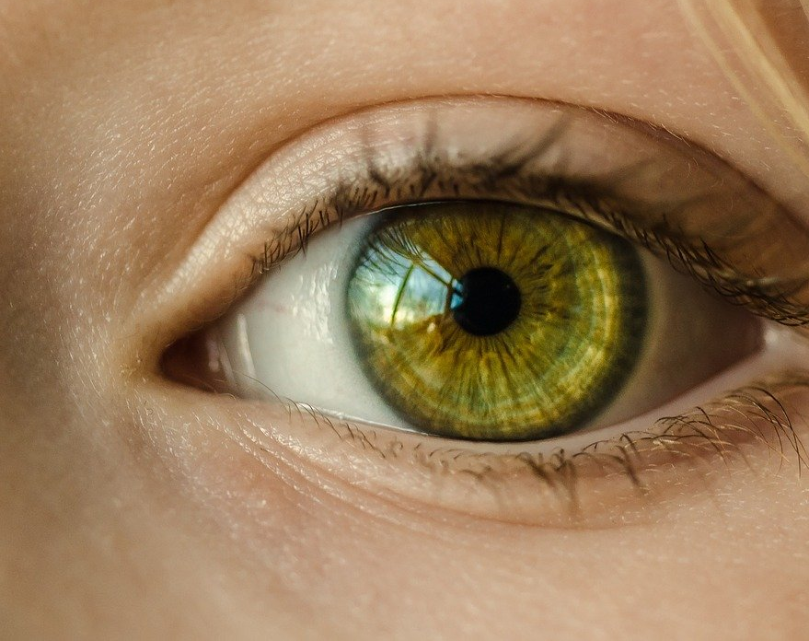
La vue
Pierre Laporte & Thibaut Stanzioni

Slide 2
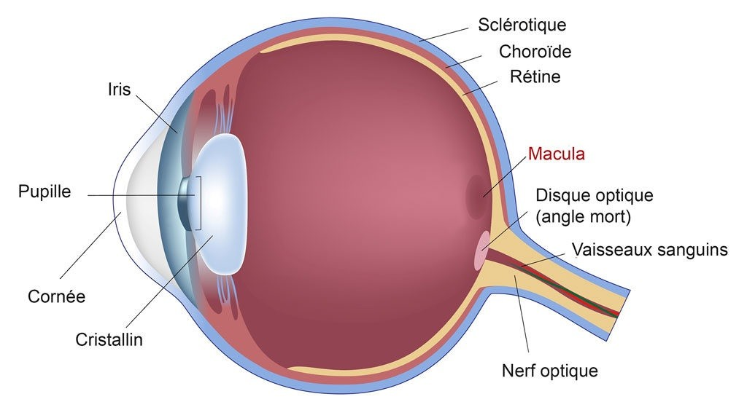
L’oeil

Slide 3
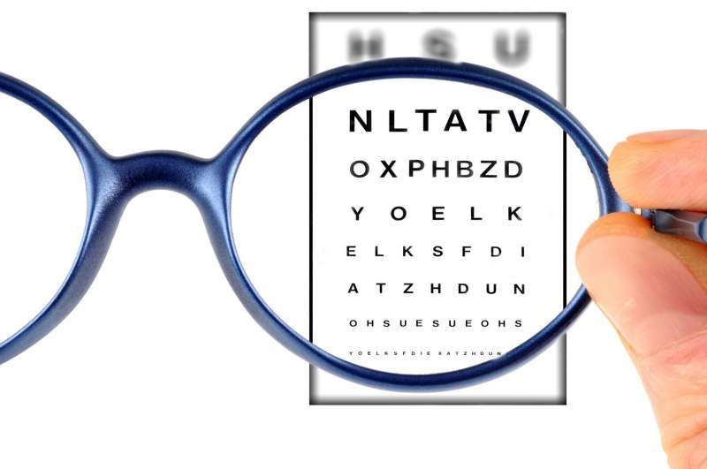
Les problèmes de vue

Slide 4
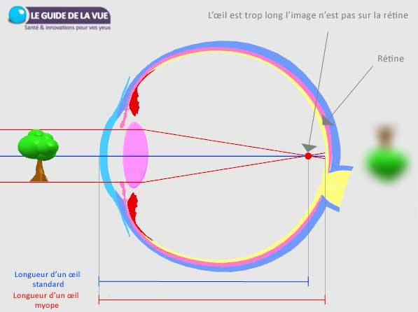
Les problèmes de vue : myopie
https://www.guide-vue.fr/la-sante-de-vos-yeux/les-defauts-visuels/la-myopie

Slide 5
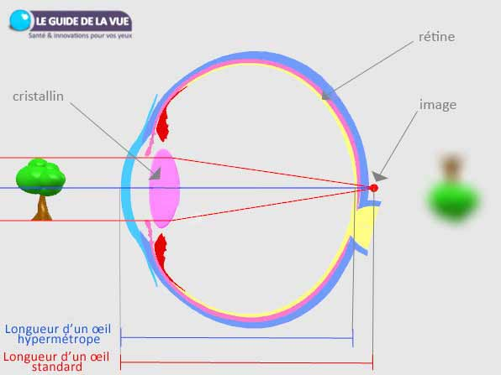
Les problèmes de vue : hypermétropie
https://www.guide-vue.fr/la-sante-de-vos-yeux/les-defauts-visuels/l-hypermetropie

Slide 6
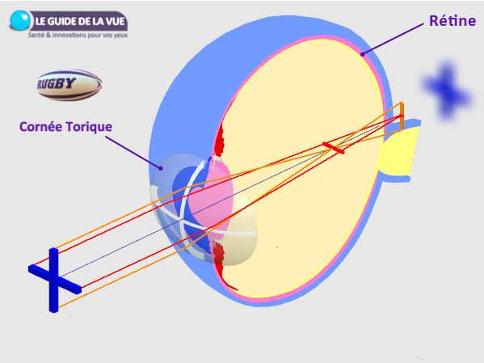
Les problèmes de vue : astigmatisme
https://www.guide-vue.fr/la-sante-de-vos-yeux/les-defauts-visuels/l-astigmatisme

Slide 7
Autres problèmes de l’oeil
Presbytie
Daltonisme
Cataracte
Strabisme
Etc.

Slide 8
Le cerveau et la vue : illusions d’optique
La grille d’Hermann

Slide 9
Le cerveau et la vue : illusions d’optique

Slide 10
Glossaire
Globe oculaire | Eyeball
Cornée | Cornea
Pupille | Pupil
Iris | Iris
Cristallin | Lens
Rétine | Retina
Macula | Macula
Fovéa | Fovea
Cônes | Cones
Bâtonnets | Rods
Nerf optique | Optic nerve
Myopie | Myopia
Hypermétropie | Hyperopia
Astigmatisme | Astigmatism
Presbytie | Presbyopia
Daltonisme | Daltonism

Slide 11
Texte à traduire
Eye Injuries From Fireworks Have Nearly Doubled
By Robert Preidt HealthDay Reporter
SUNDAY, June 30, 2019 (HealthDay News) -- As communities across America enjoy fireworks this July Fourth, folks should keep eye safety in mind.
The number of eye injuries caused by fireworks nearly doubled from 2016 to 2017, and the American Academy of Ophthalmology (AAO) is urging Americans to take proper safety precautions this holiday.
Fireworks-related eye injuries rose from 700 in 2016 to 1,200 in 2017, according to the U.S. Consumer Product Safety Commission. Those injuries included ruptured eyeballs and damaged corneas and retinas.
"An average of 280 people a day will go to the emergency room with fireworks-related injuries during the two weeks before and after July Fourth," said Dr. Dianna Seldomridge, clinical spokesperson for the AAO.
"Don't be a part of these alarming statistics. Learn how to protect yourself and your children," she urged in an AAO news release.
Most injuries are caused by legal fireworks that parents buy for their children, including sparklers, firecrackers, bottle rockets and Roman candles, according to the AAO.
The academy offered the following fireworks safety tips.
Keep a safe distance from fireworks: A recent study found that bystanders account for 65% of people injured by fireworks. Stacy Young was one of those. She was 100 yards away when shrapnel from an illegal firework penetrated her skull. Her eye couldn't be saved and had to be removed.
Don't pick up duds and misfires: Ohio firefighter Jay Northup took all the right precautions for his backyard Fourth of July fireworks celebration, but a decision to inspect a "dud" was almost fatal and nearly cost him his sight.
Supervise children closely: Sparklers seem like harmless fun for children, but they cause about 1,400 eye injuries each year. Even tiny poppers or snappers can be dangerous.
Wear protective eyewear: Buy American National Standards Institute (ANSI)-approved safety glasses for the entire family.
[…]
(317 mots)
Source : https://www.webmd.com/eye-health/news/20190630/eye-injuries-from-fireworks-have-nearly-doubled

Slide 12
Sources
https://www.franceculture.fr/sciences/objets-impossibles-ou-serpents-tournants-comment-les-illusions-doptique-trompent-votre-cerveau
https://www.youtube.com/watch?v=vQi3VMuzVjY
https://www.youtube.com/watch?v=2va8DyKjw7s
https://en.wikipedia.org/wiki/Eye
https://explorable.com/visual-system-en
https://www.guide-vue.fr/la-sante-de-vos-yeux/les-defauts-visuels/la-myopie
https://www.guide-vue.fr/la-sante-de-vos-yeux/les-defauts-visuels/l-hypermetropie
https://www.guide-vue.fr/la-sante-de-vos-yeux/les-defauts-visuels/l-astigmatisme

