Slide 1
Le toucher
Kathleen François-Rose
Myriam Dounar

Slide 2
Les mécanorécepteurs
Notes:
Pression + précision : disque de Merkel + Meissner (seulement peau glabre)
Pression + étirement : Ruffini (+ chaud)
Vibrations : Pacini
Effleurement : Follicule pileux
Douleur : terminaisons libres

Slide 3
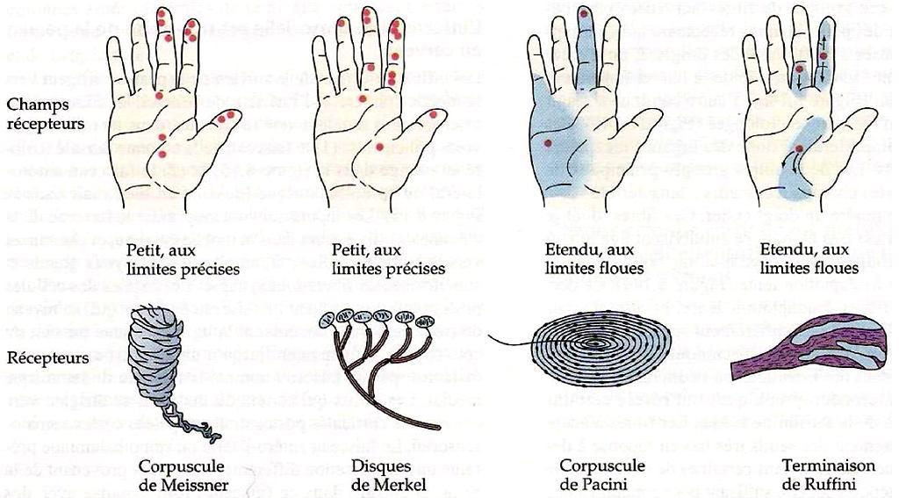
Les mécanorécepteurs

Slide 4
Troubles de la sensibilité
Hyperesthésie
Hypoesthésie
Le fait d’être assis est une torture incessante. Me toucher le front de déception m’anéanti physiquement.
Hier je me suis fait renversé par un camion et j’ai rien ressenti. La douleur c’est surfait.

Slide 5
Ressentir son environnement
Poids
Texture
Dureté
Température
Formes
Analyse des contours

Slide 6
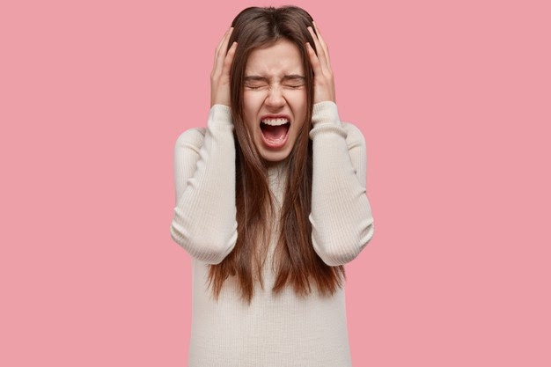
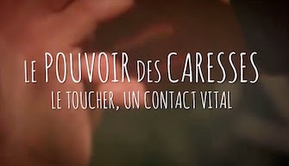

Slide 7
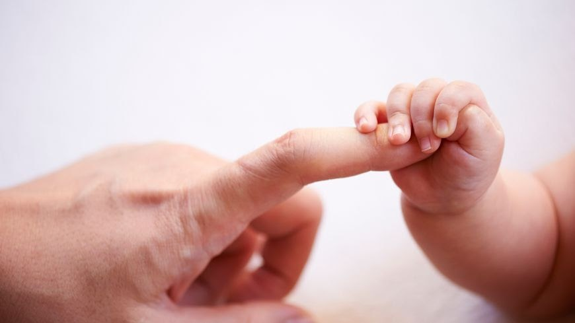

Slide 9
Le braille

Slide 10
Glossaire
FR | EN
Mécanorécepteur | Mechanoreceptor
Disque de Merkel | Merkel’s disc
Corpuscule de Meissner | Meissner’s corpuscule
Corpuscule de Pacini | Pacinian corpuscule
Corpuscule de Ruffini | Ruffini’s corpuscule
Terminaison nerveuse libre | Free nerve ending
Système nerveux central | Central nervous system
Peau glabre | Glabrous skin
Peau velue | Hairy skin
Follicule pileux | Hair follicle

Slide 11
Mechanoreceptors Specialized to Receive Tactile Information
Four major types of encapsulated mechanoreceptors are specialized to provide information to the central nervous system about touch, pressure, vibration, and cutaneous tension: Meissner's corpuscles, Pacinian corpuscles, Merkel's disks, and Ruffini's corpuscles. These receptors are referred to collectively as low-threshold (or high-sensitivity) mechanoreceptors because even weak mechanical stimulation of the skin induces them to produce action potentials. The skin harbors a variety of morphologically distinct mechanoreceptors.
Meissner's corpuscles, which lie between the dermal papillae just beneath the epidermis of the fingers, palms, and soles, are elongated receptors formed by a connective tissue capsule that comprises several lamellae of Schwann cells. The center of the capsule contains one or more afferent nerve fibers that generate rapidly adapting action potentials following minimal skin depression. Meissner's corpuscles are the most common mechanoreceptors of “glabrous” (smooth, hairless) skin (the fingertips, for instance), and their afferent fibers account for about 40% of the sensory innervation of the human hand.
Pacinian corpuscles are large encapsulated endings located in the subcutaneous tissue (and more deeply in interosseous membranes and mesenteries of the gut). These receptors differ from Meissner's corpuscles in their morphology, distribution, and response threshold. The Pacinian corpuscle has an onionlike capsule in which the inner core of membrane lamellae is separated from an outer lamella by a fluid-filled space.
Ruffini's corpuscles, although structurally similar to other tactile receptors, are not well understood. These elongated, spindle-shaped capsular specializations are located deep in the skin, as well as in ligaments and tendons. The long axis of the corpuscle is usually oriented parallel to the stretch lines in skin; thus, Ruffini's corpuscles are particularly sensitive to the cutaneous stretching produced by digit or limb movements. They account for about 20% of the receptors in the human hand and do not elicit any particular tactile sensation when stimulated electrically.
Mechanoreceptors Specialized to Receive Tactile Information - Neuroscience - NCBI Bookshelf (nih.gov)

Slide 12
Bibliographie
Soignant-soigné, trouver l’accordage pour entrer en résonance | Cairn.info
Le toucher social dans les interactions médiatisées: une approche interactionniste (archives-ouvertes.fr)
https://tel.archives-ouvertes.fr/tel-03231624/document
https://www.futura-sciences.com/sante/actualites/prix-nobel-medecine-prix-nobel-medecine-2021-decerne-david-julius-ardem-patapoutian-93931/
https://www.passeportsante.net/fr/Maux/Symptomes/Fiche.aspx?doc=hypoesthesie
https://www.larousse.fr/encyclopedie/animations/R%C3%A9cepteurs_tactiles/1100416
II) Le toucher | Le toucher peut-il remplacer la vue chez les aveugles ? (lewebpedagogique.com)
Mécanorécepteur - fr.LinkFang.org
Les Super Pouvoirs du ... Toucher | Les Echos
https://tel.archives-ouvertes.fr/tel-03231624/document

Slide 13
Thank you for listening!
Let’s keep in touch ;)

