Slide 1
Carte mère
Laudrin Mélissa & Gaultier Paul

Slide 2
Sommaire
Présentation
Schémas avec les différents composants
Glossaire
Texte
Sources

Slide 3
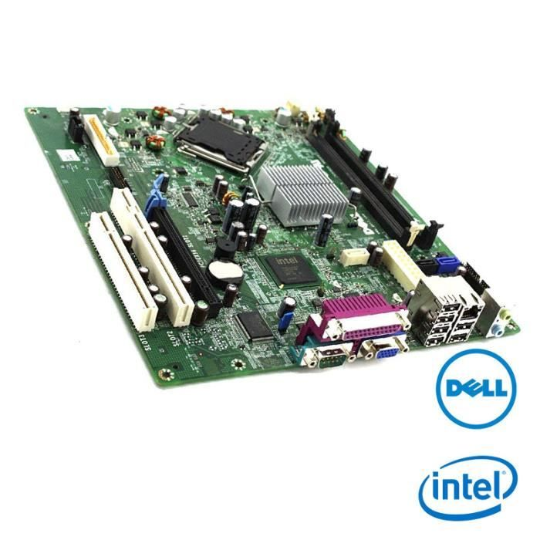
Présentation / Définition
L’élément central de tout ordinateur qui accueille les composants
Accueille la mémoire vive, le processeur, les différents ports ainsi que les extensions de cartes.
Contient le BIOS, logiciel vital à l’ordinateur.

Slide 4
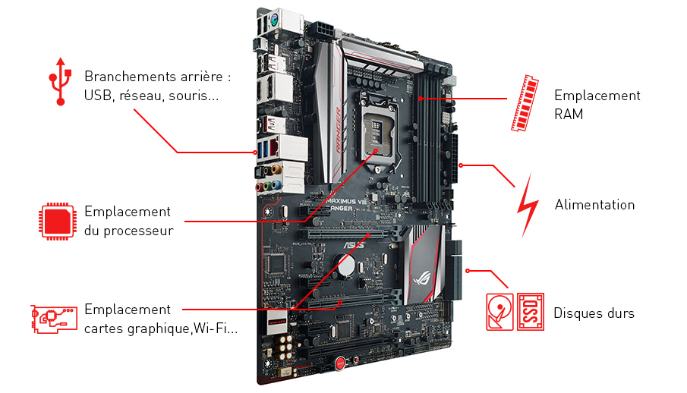

Slide 5
Glossaire
carte mère : motherboard
processeur : processor
bus : bus
chipset : jeu de puce
PCI (Peripheral Component Interconnect) slot : port PCI
BIOS (Basic Input Output System) : BIOS
socket : support processeur
CPU : processeur
I/O (input/output) : E/S (entrée/sortie)
Heat sink : Dissipateur thermique

Slide 6
What components make up a motherboard?
There are several different motherboard designs and form factors, which have been updated over the years for different devices and evolving technology. However, all motherboards have a few things in common. All of them have circuits used to coordinate computer processes and a heat sink for absorbing and redirecting heat to keep the motherboard cool during use. Most have a secondary source of power, too.
The primary thing you’ll notice when you look at any motherboard is that it has a lot of slots and connections. Since everything is routed through the motherboard, it needs physical contact with nearly all computer components. That includes main power, CPU, RAM slots, USB, PCI, video and sound cards, and expansion slots.
If you use a wireless mouse or external keyboard, they have their connections along with any other essential accessory you might want. This utility is why a motherboard appears to be a ring of connectors — that’s its primary function.
Over time the ports on a motherboard tend to change based on what current technology demands. This is why an old motherboard may have many defunct ports for connections that are obsolete.
However, we will note two essential connections, specifically the connection to the CPU and the connection to power (I/O) functions. Commonly regarded as the two most crucial motherboard connections, CPU and power make up the backbone of the circuit. Together, they are called the chipset — the core management of power and processing for all tasks.

Slide 7
SOURCES
https://www.education.gouv.fr/bo/2002/47/encart.htm
https://www.journaldunet.fr/web-tech/dictionnaire-du-webmastering/1445216-carte-mere-definition-technique-et-nom-des-composants/
https://www.digitaltrends.com/computing/what-is-a-motherboard/
https://community.lecrabeinfo.net/topic/6132-tuto-choisir-son-pc/

