Slide 1
Le disque SSD
Yéléna Fares & Mathilde Stenger

Slide 2
I. Définition
support de stockage qui utilise des puces de mémoire flash
= disque dur (support de stockage magnétique)

Slide 3
II. Fonctionnement

Slide 4
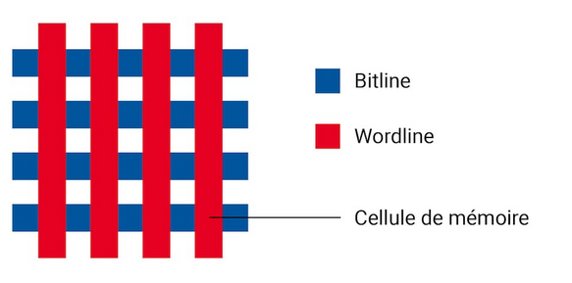
1. La mémoire flash NAND
sauvegarde les données de manière durable en créant une tension
lecture et écriture électroniques des données
Bloc NAND :

Slide 5
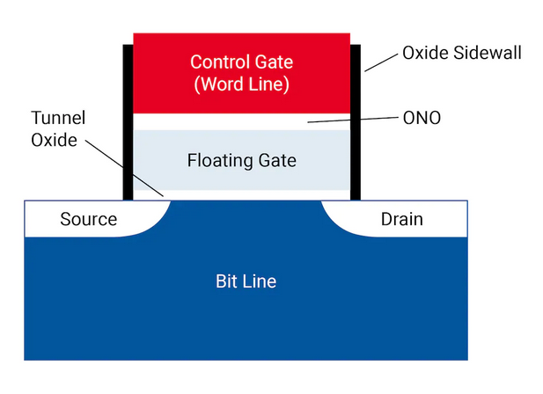
1. La mémoire flash NAND
Cellule mémoire : transitor à grille flottante à effet de champ et structure métal-oxyde-semiconducteur (Floating Gate Metal Oxide Semiconductor Field Effect Transistors» (FGMOS))
Grille flottante

Slide 6
1. La mémoire flash NAND
Données enregistrées quand les électrons sont posés sur la grille flottante ou vien enlevés de celle-ci
Bits lus à l’aide de la tension :
Si presence d’électron, bit = 0 (cellule écrite)
Si non, bit =1 (cellule effacée)

Slide 7
1. La mémoire flash NAND
Fonctionnement
À l’écriture des données : une tension positive circule entre «source» et « drain ». Lors du déplacement, les électrons sont attirés et emprisonnés dans la grille flottante.
À l’effacement des données : une tension négative est envoyée dans la grille de contrôle, la grille flottante va se vider de ses électrons
À la lecture des données : une tension va être envoyée sur la grille flottante pour tester sa résistance. Si la grille est isolante, 0 binaire ; dans le cas contraire, c’est 1 binaire.

Slide 8
2. Le contrôleur
Mémoire vive intégrée
Firmware : logiciel permettant le fonctionnement du métériel
Collecte de déchets, gestion de l’usure, …

Slide 9
3. La connexion SATA
Permet le transfert de données aux interfaces, périphériques

Slide 10
III. Différences entre le disque dur et le disque SSD
1. Rappel

Slide 11
2. Les avantages du SSD

Slide 12
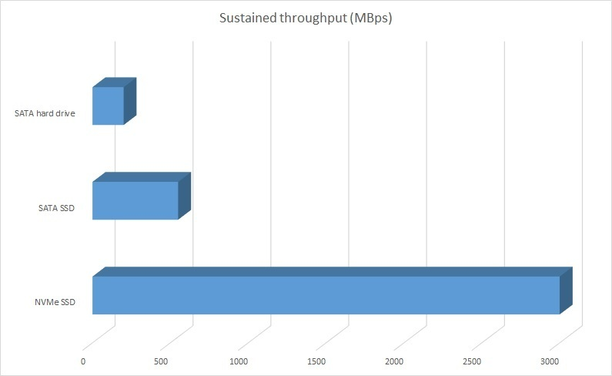
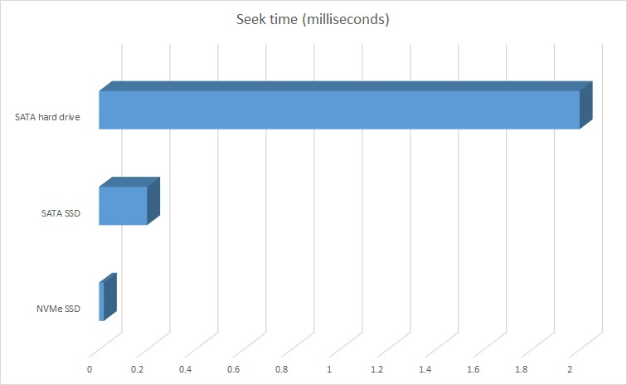
3. Les différentes interfaces et formats
Les principales interfaces : SATA, PCIe, M.2 et NVMe
Protocole NVMe :

Slide 13
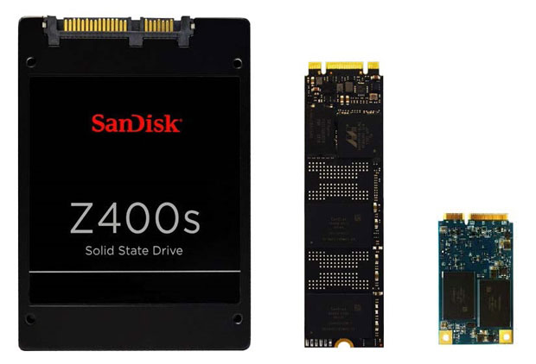
3. Les différentes interfaces et formats
Les principaux formats : 2,5 pouces, mSATA, M.2 2280
SATA - M.2 - mSATA

Slide 14
Glossaire
Mémoire flash : flash memory
Contrôleur : controller
Connexion SATA : SATA connexion
Ligne de bits : bitline
Ligne de mots : wordline
Floating gate : ligne flottante

Slide 15
Texte
How are the top trends changing the solid state storage market?
More capacity, more speed and greater efficiency – the future is bright for SSDs
What does the future hold for solid state storage? The better question might be, what does solid state technology hold for the future of storage? With consumer and enterprise demand showing no signs of slowing, solid state storage is well on its way to replacing traditional hard disk drives (HDDs)—it’s just a matter of how soon. Yet solid state storage is quite diverse and is evolving year by year. Let’s take a look at some of the latest solid state storage trends affecting 2020 and beyond. Ever-increasing market share As of last year, the solid state storage market was valued at USD 34 billion, and it’s expected to nearly triple in less than five years with current projections predicting the market valuation will hit $80 billion by 2025. A large part of the rising demand comes from enterprise storage. Today’s data centers are increasingly turning to solid state storage options as they tackle the complex tasks presented by edge computing, IoT data analysis, high-performance computing (HPC), deep learning and other next-generation tasks. Newer NAND The first SSDs employed single-level cell (SLC) NAND flash, recording information one bit per cell, which is highly durable at 100,000 writes per cell. Newer advancements in NAND technology include 2D NAND and 3D NAND (writing at 2 bits per cell and three bits per cell, respectively), which are less durable but allow for higher capacity at a lower cost, and for that reason are highly useful as enterprise storage. Four-bit per cell 3D NAND memory exists, but durability issues with the current technology make it unsuited for enterprise applications. Mobile storage While most mobile device manufacturers continue to push cloud storage options, local storage on phones and tablets is still increasing, thanks to advancements in SSD technology. One recent example is Toshiba’s announcement of XFMEXPRESS, a new NVMe format designed to enhance all sorts of mobile storage applications from phones to car infotainment units to gaming consoles. NVMe dominance Original SSDs relied on the existing SATA protocol, which limited the speed at which storage could offload information to a motherboard. Now, more and more manufacturers are bypassing SATA with NVMe, which uses the PCIe protocol and allows for speeds that far exceed what SATA can offer. Because of this advantage, NVMe is expected to become the dominant storage interface for the foreseeable future. Solid state storage sales are expected to continue their sharp increase in the next five years. Encourage your customers to explore how their businesses could benefit from the latest innovations in storage technology.

Slide 16
Liens
https://www.grosbill.com/3-guide_achat_ssd-ssd_pourquoi_un_ssd-cat-guides_achat
https://www.lesateliersinformatiques.fr/blog/difference-entre-ssd-disque-dur/
https://www.culture-informatique.net/cest-quoi-disque-dur-ssd/
http://www.aidewindows.net/materiel_ssd-interface.php
https://www.lemondeinformatique.fr/actualites/lire-tout-savoir-sur-le-nvme-74598.html
https://www.crucial.fr/articles/about-ssd/what-is-an-SSD
https://www.digitec.ch/fr/page/le-fonctionnement-dun-disque-ssd-est-une-affaire-complexe-7399
http://tpe2013bst.e-monsite.com/pages/les-memoires-flash.html
https://www.digitec.ch/fr/page/le-fonctionnement-dun-disque-ssd-est-une-affaire-complexe-7399
https://imaginenext.ingrammicro.com/data-center/how-are-the-top-trends-changing-the-solid-state-storage-market

