Slide 1
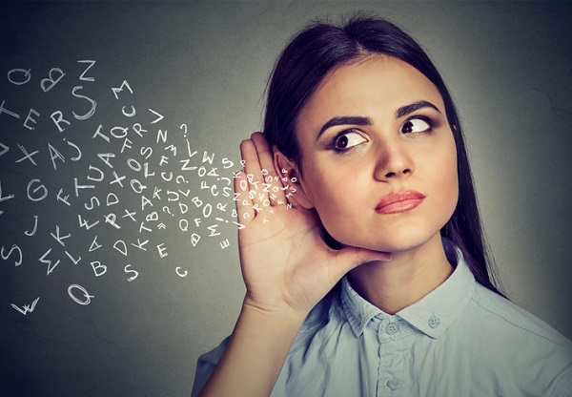
L'ouïe
Armelle Scudeller
Simone Parisi

Slide 2
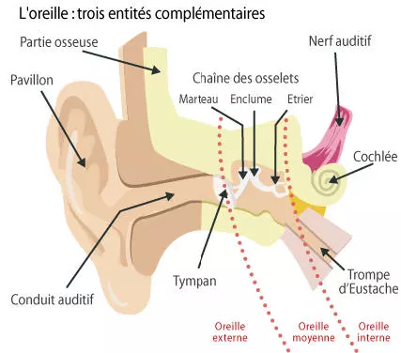

Slide 3
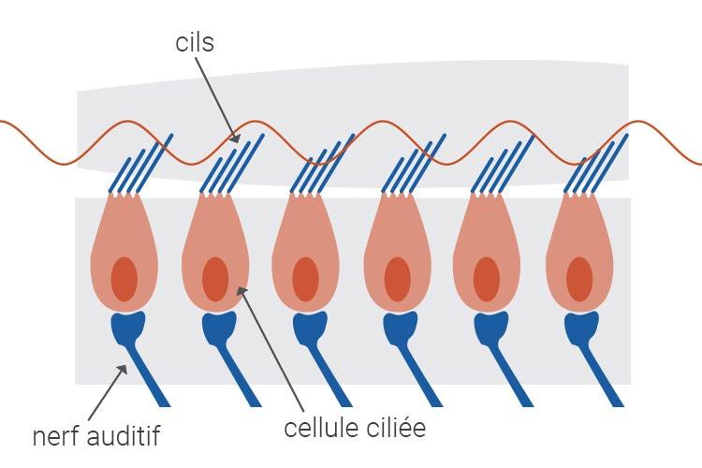

Slide 4
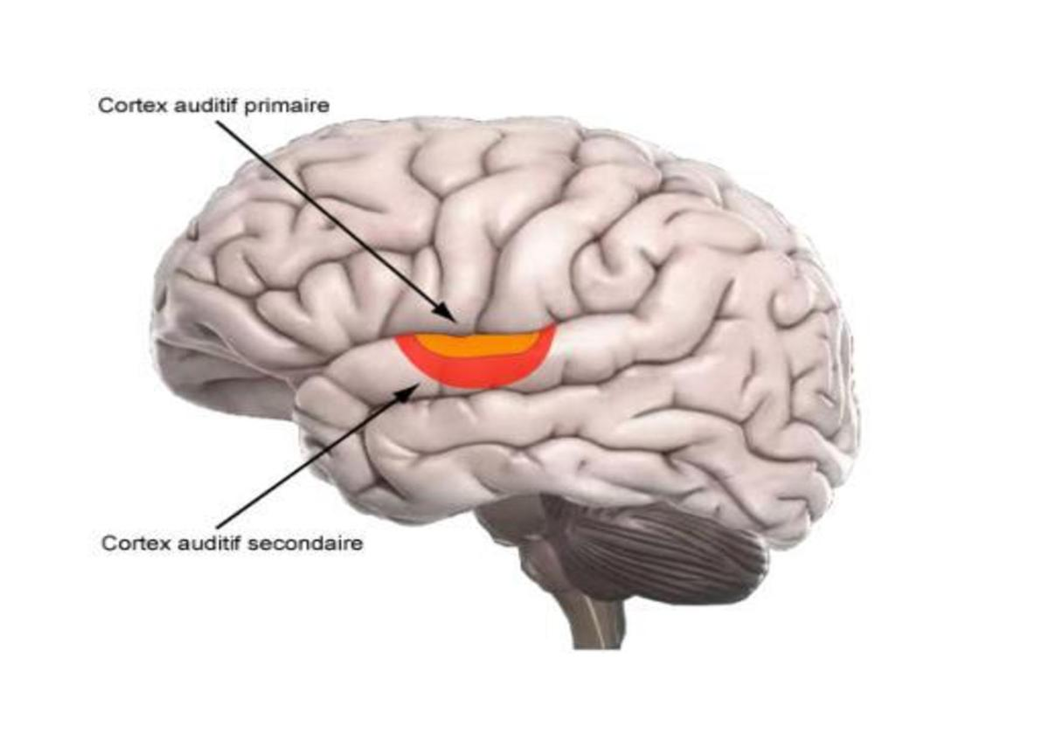

Slide 5
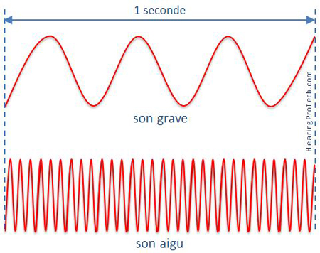
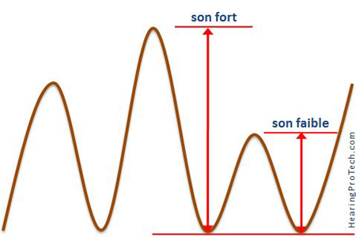
Les sons se caractérisent par deux facteurs :
la hauteur qui est mesurée selon la fréquence de vibration du son et qui s’exprime en Hertz (Hz) ;
l’intensité qui s’exprime en décibel (dB).

Slide 6
Hauteur
Infrasons : sons ayant une fréquence inférieure à 20 Hz
Ultrasons : sons ayant une fréquence supérieure à 20 000 Hz

Slide 7
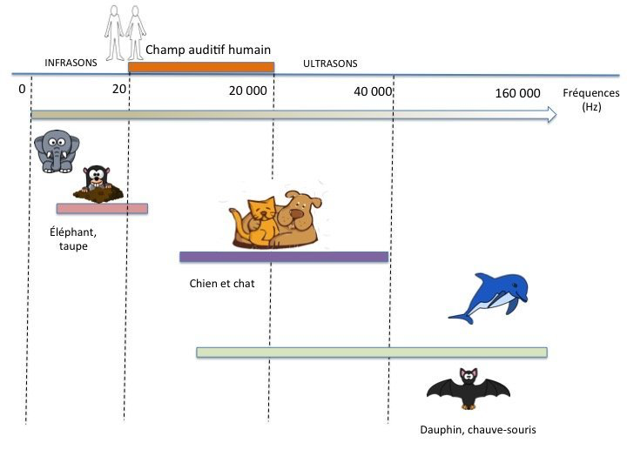
Différence avec les autres espèces

Slide 8
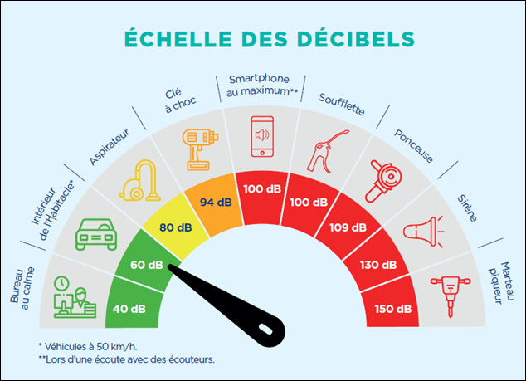
Intensité

Slide 9
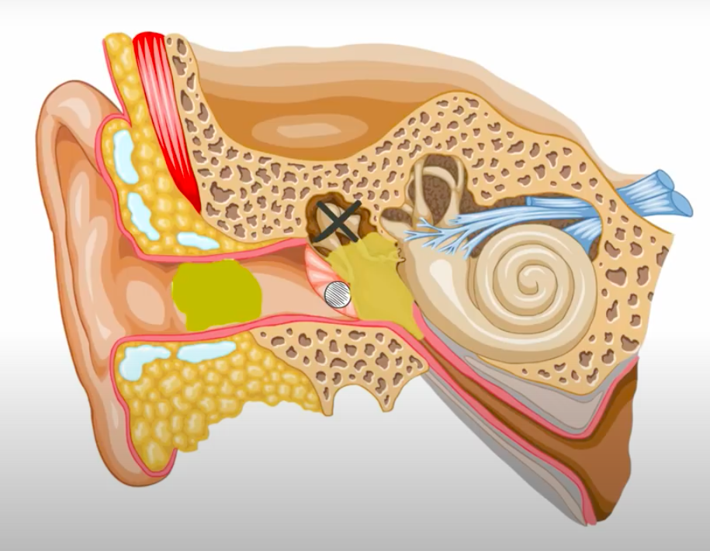
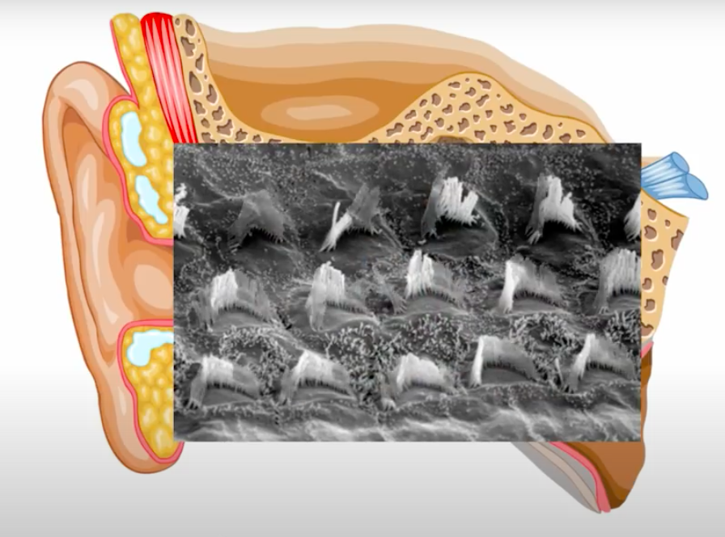
La perte auditive
Surdité de perception
Surdité de transmission

Slide 10
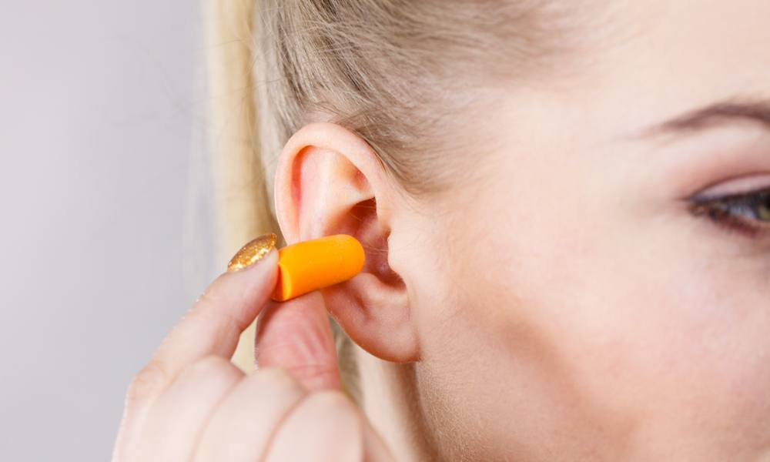
Comment préserver son audition ?
Se protéger les oreilles dans des environnements bruyants
Réduire le volume lorsqu’on porte des casques ou écouteurs
Accorder un temps de récupération à ses oreilles
Eviter l’excès d’humidité dans le canal auditif
...

Slide 11
Glossaire
Canal auditif | Ear canal
Cellule ciliée | Hair cell
Cochlée | Cochlea
Enclume | Incus
Etrier | Stapes
Marteau | Malleus
Nerf auditif | Auditory nerve
Onde sonore | Sound wave
Oreille externe | Outer ear

Slide 12
Glossaire
Oreille interne | Inner ear
Oreille moyenne | Middle ear
Osselet | Ossicle
Pavillon auriculaire | Ear pavillon
Perte auditive | Hearing loss
Surdité de perception | Sensorineural hearing loss
Surdité de transmission | Conduction hearing loss
Système vestibulaire | Vestibular system
Tympan | Ear drum

Slide 13
Texte à traduire
Causes of Hearing Loss
Loud noise is one of the most common causes of hearing loss. Noise from lawn mowers, snow blowers, or loud music can damage the inner ear, resulting in permanent hearing loss. Loud noise also contributes to tinnitus. You can prevent most noise-related hearing loss. Protect yourself by turning down the sound on your stereo, television, or headphones; moving away from loud noise; or using earplugs or other ear protection.
Earwax or fluid buildup can block sounds that are carried from the eardrum to the inner ear. If wax blockage is a problem, talk with your doctor. He or she may suggest mild treatments to soften earwax.
A punctured ear drum can also cause hearing loss. The eardrum can be damaged by infection, pressure, or putting objects in the ear, including cotton-tipped swabs. See your doctor if you have pain or fluid draining from the ear.
Health conditions common in older people, such as diabetes or high blood pressure, can contribute to hearing loss. Viruses and bacteria (including the ear infection otitis media), a heart condition, stroke, brain injury, or a tumor may also affect your hearing.
Hearing loss can also result from taking certain medications. “Ototoxic” medications damage the inner ear, sometimes permanently. Some ototoxic drugs include medicines used to treat serious infections, cancer, and heart disease. Some antibiotics are ototoxic. Even aspirin at some dosages can cause problems. Check with your doctor if you notice a problem while taking a medication.
Heredity can cause hearing loss, as well. But not all inherited forms of hearing loss take place at birth. Some forms can show up later in life. For example, in otosclerosis, which is thought to be a hereditary disease, an abnormal growth of bone prevents structures within the ear from working properly.
[300 words]
source: https://www.nia.nih.gov/health/hearing-loss-common-problem-older-adults

Slide 14
Sources
https://www.orosound.com/fr/louie-le-plus-fascinant-des-sens/
https://www.fondationpourlaudition.org/fr/quest-ce-que-le-son-514
https://www.laboratoires-unisson.com/fonctionnement-systeme-auditif.html
https://www.wanimo.com/veterinaire/votre-animal-et-vous/comportement/comment-les-animaux-entendent-ils.html
https://sites.google.com/site/lesondanslemondeanimal/qu-est-ce-que-le-son/1-2---ultrason-et-infrason
https://www.verbotonale-phonetique.com/communication-humaine-vs-communication-animale-1-2/
https://www.resound.com/fr-fr/hearing-loss/understanding/types
https://www.youtube.com/watch?v=eQEaiZ2j9oc&feature=youtu.be
https://www.youtube.com/watch?v=k-1FjLaIK74
https://www.youtube.com/watch?v=SU_aecxckRg
https://www.youtube.com/watch?v=G1djY9QJhaU
https://www.youtube.com/watch?v=I-kty9Ltqg4

Slide 15
Merci de votre oreille attentive !

