Slide 1
Le pétrole
Patricia Brunet
Eva Chevrier

Slide 2
Définition du pétrole
Huile minérale
Mélange d'hydrocarbures
Composés organiques
“Huile minérale naturelle, de couleur très foncée, d'une densité variant de 0,8 à 0,95, composée essentiellement d'hydrocarbures paraffiniques, naphténiques et aromatiques. (On dit aussi pétrole brut et, dans les opérations d'exploration et de production, huile.)” Larousse
Lat. : Petra Oleum (huile de pierre)
Énergie fossile
XIXème siècle
États-Unis, Arabie Saoudite, Russie

Slide 3
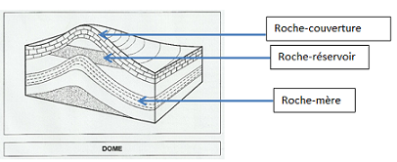
Formation du pétrole et processus
Débris organiques microscopiques
Fond des mers, deltas
Bactéries anaérobies
Dizaines de millions d’années
Entre 1000 et 3000 mètres de profondeur

Slide 4
Définition de l’extraction de pétrole
L'extraction de pétrole est le processus par lequel le pétrole utilisable est extrait et retiré du sous sol.
Par forage d’exploration
Puis par forage rotatif
tige de forage
trépan
train de tiges
boue de forage
déblais

Slide 5
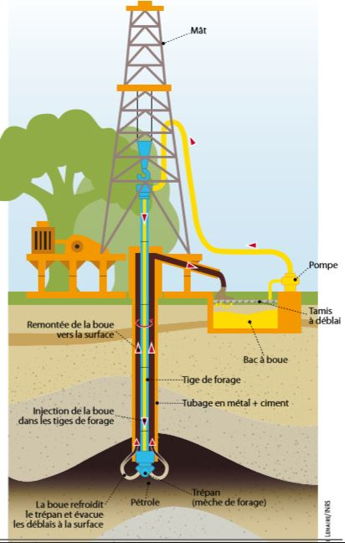

Slide 6
The rapid expansion of shale gas and shale oil exploration and exploitation using hydraulic fracturing techniques has created an energy boom in the USA but raised questions regarding the possible environmental risks, such as the potential for groundwater contamination (e.g. Jackson et al., 2013; Vidic et al., 2013) and fugitive emissions of hydrocarbons in to the atmosphere (e.g. Miller et al., 2013). Boreholes drilled to explore for and extract hydrocarbons must penetrate shallower strata before reaching the target horizons.
Some of the shallower strata may contain groundwater used for human consumption or which supports surface water ﬂows and wetland ecosystems. Although it has been routine practice to seal wells passing through suchlayers, they remain a potential source of ﬂuid mixing in the subsurface and potential contamination (King and King, 2013). This can occur for many reasons, including poor well completion practices, the corrosion of steel casing, and the deterioration of cement during production or after well abandonment. Boreholes can then become high-permeability potential conduits for both natural and man-made ﬂuids (e.g. Watson and Bachu, 2009), and vertical pressure gradients in the subsurface can drive movement of ﬂuids along these ﬂow paths. The potential importance of wellbore integrity to the protection of shallow groundwater has recently been highlighted in research papers and reports (e.g. Osborn et al., 2011; The Royal Society & The Royal Academy of Engineering Report (2012); Jackson et al., 2013; King and King, 2013).
Marine and Petroleum geology, Oil and gas wells and their integrity: implication for shales and unconventional resource exploration, published on March, 25th, 2014, Richard J. Daviesa, Sam Almonda, Robert S. Wardb, Robert B. Jacksonc,d, Charlotte Adamsa, Fred Worralla, Liam G. Herringshawa, Jon G. Gluyasa, Mark A. Whiteheade

Slide 7
Terminologie
Terme EN | Nat. | Concordant FR | Nat. | Commentaire | Source
shale oil | n. | huile de schiste | n.f. |  | 1
hydraulic fracturing technique | n. | technique de fracturation hydraulique | n.f. |  | 1
groundwater | n. | nappe phréatique | n.f. |  | 1
hydrocarbon | n. | hydrocarbure | n.m. |  | 1
borehole | n. | trou de sonde | n.m. |  | 3
drill | v. | forer | v. |  | 2
well | n. | puits | n.m. | syn. EN wellbore | 2
subsurface | n. | sous-sol | n.m. |  | 1

Slide 8
Sources
Sources pour l’exposé:
https://www.futura-sciences.com/sciences/definitions/chimie-petrole-9749/
https://www.larousse.fr/dictionnaires/francais/pétrole/60015?q=p%c3%a9trole#59641
http://sigessn.brgm.fr/spip.php?article257
https://www.larousse.fr/dictionnaires/francais/extraction/32440
Lien vers le texte source
https://core.ac.uk/download/pdf/151160838.pdf
Sources terminologiques
https://www.diplomatie.gouv.fr/IMG/pdf/carnetscaps17cb_cle0272a5.pdf (1)
https://www.ecologique-solidaire.gouv.fr/ressources-en-hydrocarbures-france (2)
http://www.pyrenees-atlantiques.gouv.fr/index.php/content/download/27726/179588/file/ilovepdf_com-101-250-compressé.pdf (3)
Petit plus:
www.culture.gouv.fr › version › file › vocabulaire_2015_petrole_enligne

Slide 9
MERCI

